Slide 1

CREDIT CARD FRAUD DETECTION ANALYSIS
MACHINE LEARNING

Slide 2
PROBLEM STATEMENT
Credit card fraud poses a significant threat to financial institutions and cardholders alike, resulting in substantial financial losses and undermining trust in the financial system. By predicting fraudulent transactions, we aim to mitigate the adverse impact of fraud on both financial institutions and cardholders. Early detection of fraudulent activity allows financial institutions to take prompt action, such as blocking compromised accounts and notifying affected customers, thereby minimizing financial losses and preserving customer trust. Moreover, accurate fraud detection contributes to enhancing overall financial security, fostering a safer environment for electronic transactions and bolstering confidence in the integrity of the financial system.

Slide 3
PROPOSED SOLUTION
Data Preprocessing:
Explore the dataset to understand its structure and characteristics.
Handle missing values if any, by imputation or removal.
Scale numerical features to ensure uniformity in their range.
Encode categorical variables if present using techniques like one-hot encoding or label encoding.
Feature Engineering:
Since the dataset contains principal components resulting from PCA transformation, further feature engineering might not be necessary. However, if deemed appropriate, additional features can be extracted or existing ones transformed to improve model performance.
Model Development:
Build and fine-tune machine learning models suitable for the problem, including:
Logistic Regression
Decision Trees
Random Forests
XGBoost
Consider techniques for handling class imbalance, such as:
Resampling methods (oversampling minority class, undersampling majority class)
Algorithmic approaches (class weights, cost-sensitive learning)
Train the models using the prepared dataset.

Slide 4
Evaluation:
Assess model performance using appropriate evaluation metrics such as:
Accuracy
Precision
Recall
F1-score
Area Under the ROC Curve (ROC AUC)
Utilize techniques like cross-validation to obtain reliable estimates of performance.
Hyperparameter Tuning:
Optimize model hyperparameters using techniques like:
Grid search
Randomized search
Focus on optimizing for metrics relevant to fraud detection, such as recall or ROC AUC.4
Deployment:
Deploy the final model into a production environment for real-time fraud detection.
Ensure integration with existing systems and workflows within financial institutions.
Implement mechanisms for model monitoring and periodic retraining to maintain effectiveness over time.

Slide 5
System Approach
NumPy: NumPy is used for numerical computing in Python. It provides support for large, multi-dimensional arrays and matrices, along with a collection of mathematical functions to operate on these arrays efficiently.
Pandas: Pandas is used for data manipulation and analysis. It provides data structures like DataFrame for working with structured data, making tasks such as data preprocessing and feature engineering easier.
XGBoost: XGBoost is an optimized and scalable gradient boosting library used for classification and regression tasks. It provides high performance and accuracy, making it suitable for handling imbalanced datasets like the one in the fraud detection project.
Scikit-learn: Scikit-learn is a machine learning library in Python. It provides simple and efficient tools for data analysis and modeling, including algorithms for classification, regression, clustering, dimensionality reduction, and model selection.
Seaborn: Seaborn is a data visualization library based on Matplotlib. It provides a high-level interface for drawing attractive and informative statistical graphics, making it useful for visualizing data distributions, relationships between variables, and model performance metrics.
SciPy: SciPy is used for scientific and technical computing. It provides functions for numerical integration, optimization, interpolation, and other mathematical tasks that may be required during model development and evaluation.

Slide 6
Statsmodels: Statsmodels is a Python module that provides classes and functions for the estimation of many different statistical models, as well as for conducting statistical tests and exploratory data analysis.
Matplotlib: Matplotlib is a comprehensive library for creating static, interactive, and animated visualizations in Python. It provides a wide variety of plotting functions and customization options for creating publication-quality plots.

Slide 7
Algorithm & Deployment
Algorithm Selection:
Logistic Regression with L1 and L2 Regularization :
Overview: Logistic regression is a linear classification algorithm used for binary classification tasks. It models the probability of a binary outcome based on one or more predictor variables.
Justification: Logistic regression is a simple yet effective algorithm that provides interpretable results. It can serve as a baseline model for binary classification tasks and is suitable for datasets with relatively simple relationships between features and the target variable.
K-Nearest Neighbors (KNN) Model :
Overview: KNN is a non-parametric classification algorithm that classifies a data point based on the majority class of its k nearest neighbors in the feature space.
Justification: KNN is intuitive and easy to understand, making it a good choice for initial exploration of the data. It can capture complex patterns in the data without making strong assumptions about the underlying distribution.
Decision Tree Models with 'gini' and 'entropy' Criteria :
Overview: Decision trees are hierarchical tree-like structures where nodes represent features, branches represent decisions, and leaves represent class labels. 'Gini' and 'entropy' are criteria used to measure the impurity of a node in decision tree algorithms.
Justification: Decision trees are interpretable and can handle both numerical and categorical data. By using different impurity criteria like 'gini' and 'entropy', the decision tree models can capture different aspects of the data distribution and potentially improve performance.

Slide 8
Random Forest Model:
Overview: Random Forest is an ensemble learning method that constructs multiple decision trees during training and outputs the mode of the classes (classification) or the mean prediction (regression) of the individual trees.
Justification: Random Forests are robust against overfitting and tend to perform well on various types of datasets. They can handle large datasets with high dimensionality and provide estimates of feature importance, aiding in the interpretation of the results.
XGBoost Model:
Overview: XGBoost (Extreme Gradient Boosting) is an advanced implementation of gradient boosting algorithms. It builds multiple decision trees sequentially, where each tree corrects the errors made by the previous one.
Justification: XGBoost is known for its high performance, scalability, and handling of complex datasets. It typically outperforms other algorithms in terms of predictive accuracy and is widely used in data science competitions and real-world applications.

Slide 9
Data Input:
Principal Components (V1-V28): These are numerical input variables resulting from a Principal Component Analysis (PCA) transformation. These features represent the transformed attributes derived from the original data. Due to confidentiality reasons, the original features and background information are not provided. These principal components capture the most significant variations in the dataset.
Time: This feature represents the elapsed time in seconds between each transaction and the first transaction in the dataset. It provides temporal information about when each transaction occurred, which could potentially be useful in identifying patterns or anomalies in transaction timing.
Amount: This feature denotes the transaction amount. It represents the monetary value of each transaction, providing crucial information about the financial aspect of each transaction.
Notes:
Data Input:

Slide 10
Training Process:
Data Preprocessing: The historical data, comprising credit card transactions, is preprocessed to handle missing values, scale features, and possibly address outliers. In this case, since the dataset contains only numerical features resulting from PCA transformation, preprocessing may involve standardization or normalization of these features.
Feature Engineering: While the original features are not provided due to confidentiality reasons, the existing principal components (V1-V28), time, and amount variables are used as input features for training the algorithm. Feature engineering techniques may involve further transformations or combinations of these features to enhance model performance.
Model Selection: A machine learning algorithm, such as XGBoost, is chosen for training due to its effectiveness in handling imbalanced datasets and its ability to capture complex relationships in the data. XGBoost is a popular choice for fraud detection tasks because of its robustness and flexibility.
Cross-Validation: Given the highly imbalanced nature of the dataset, cross-validation techniques, such as Stratified K-Fold Cross-Validation, are employed to ensure that each fold contains a proportional representation of both fraudulent and non-fraudulent transactions. This helps prevent overfitting and provides more reliable estimates of model performance.

Slide 11
Hyperparameter Tuning: Hyperparameters of the XGBoost algorithm, such as learning rate, maximum depth, and the number of estimators, are optimized using techniques like Randomized Search or Grid Search Cross-Validation. Hyperparameter tuning helps improve model generalization and performance on unseen data.
Training the Algorithm: The XGBoost classifier is trained on the preprocessed and engineered historical data using the selected features and optimized hyperparameters. During training, the algorithm learns to distinguish between fraudulent and non-fraudulent transactions based on patterns and relationships present in the historical data.
Model Evaluation: The trained model's performance is evaluated using appropriate evaluation metrics, such as accuracy, precision, recall, F1-score, and Area Under the ROC Curve (AUC-ROC). Since the dataset is highly imbalanced, metrics like AUC-ROC and Area Under the Precision-Recall Curve (AUC-PRC) are preferred over accuracy for assessing model performance.

Slide 12
Prediction Process:
The trained algorithm makes predictions based on the learned patterns and relationships in the historical data. Here's a detailed explanation of how the algorithm makes predictions and the real-time data inputs considered during the prediction phase:
Feature Extraction: During the prediction phase, real-time data inputs are collected, which typically include the same features as those used during training. These features may include:
Principal Components (V1-V28): Numerical input variables resulting from PCA transformation.
Time: Elapsed time in seconds between each transaction and the first transaction in the dataset.
Amount: The transaction amount.
Preprocessing: The real-time data inputs are preprocessed using the same preprocessing steps applied during training. This may involve handling missing values, scaling features, and applying any necessary transformations to ensure consistency with the training data.

Slide 13
Prediction: Once the real-time data inputs are preprocessed, they are fed into the trained XGBoost model. The model then applies the learned patterns and relationships to the input data to predict whether each transaction is fraudulent or not. For binary classification tasks like fraud detection, the model outputs a probability score indicating the likelihood of the transaction being fraudulent (Class 1) or non-fraudulent (Class 0).
Thresholding: The predicted probability scores are compared to a predefined threshold to classify transactions as either fraudulent or non-fraudulent. The threshold is typically set based on the desired balance between false positives and false negatives, taking into account the specific requirements of the application.
Real-Time Decision Making: Based on the model predictions, financial institutions or fraud detection systems can take appropriate actions in real-time. For example:
If the predicted probability of fraud exceeds the threshold, the transaction may be flagged for further review or verification.
If the predicted probability is below the threshold, the transaction is approved and processed normally.
Feedback Loop: Predictions made during the real-time phase can be used to update the model and improve its performance over time. This feedback loop involves collecting additional labeled data based on the outcomes of predicted transactions and retraining the model periodically to incorporate new information and adapt to changing patterns of fraudulent activity.

Slide 14
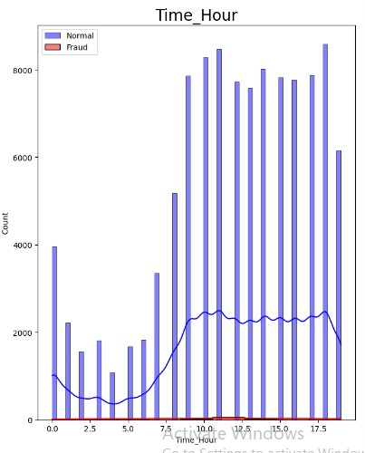
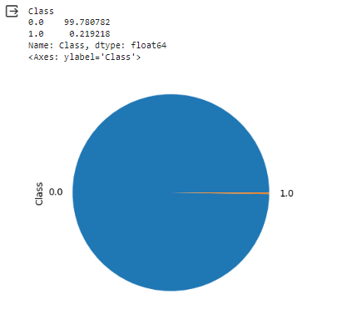
Result
1. Checking the class distribution of target variable in percentage.Checking the pie chart for Fraudulent and Legitimate Transcastions.
2. Plot the histogram of values from the dataset to see the skewness

Slide 15
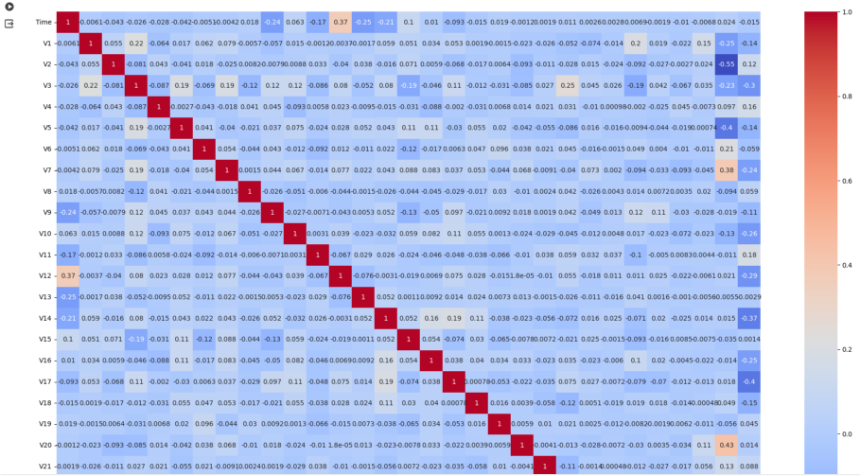
2. Checking the correlation in heatmap

Slide 16
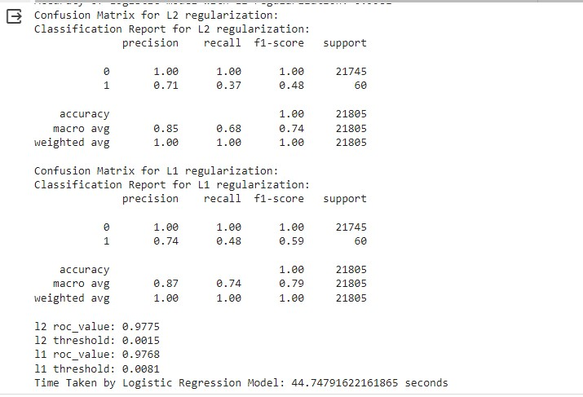
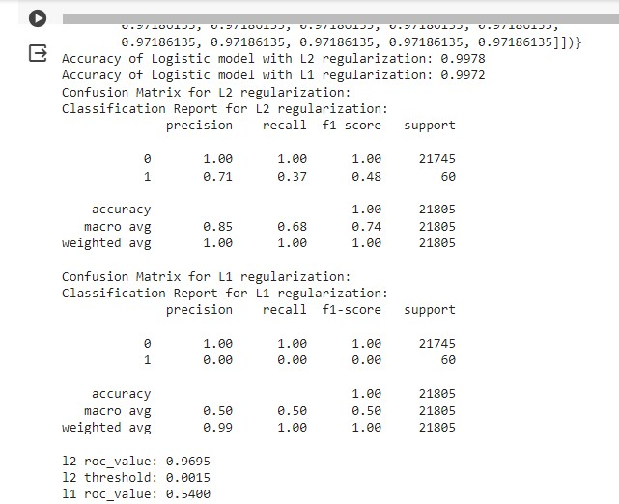
Model Building
Conclusion:
As a result Logistic Regression with L2 Regularisation for StratifiedKFold cross-validation provided the best results.
Perform cross validation with RepeatedKFold
Perform cross-validation with StratifiedKFold

Slide 17
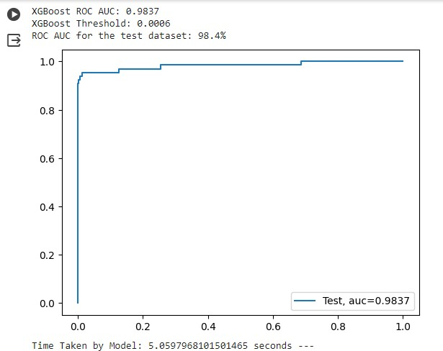
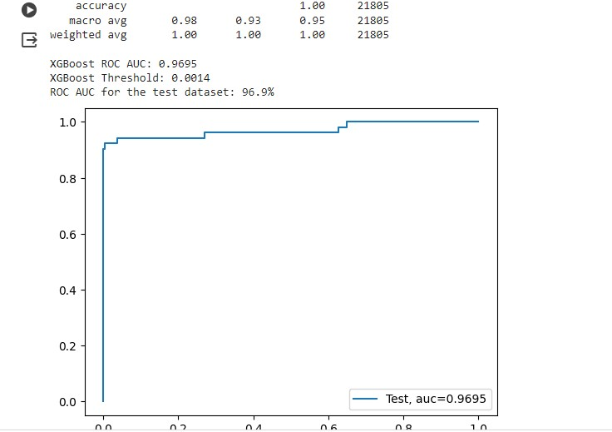
Model Building with Balancing Classes
Perform class balancing with:
Random OverSampling.
SMOTE
ADASYN
Oversampling with RandomOversampling with StartifiedKFold Cross validation
OverSampling with SMOTE OverSampling.
Results for SMOTE OverSampling with StratifiedKFold:
Looking at the Accuracy and Roc value we have XBoost which has provided best results for Random OverSampling and StratifiedKFold technique.
Looking at Accuracy and ROC value we have XBOOst which has provided best results for SMOTE OverSampling with StartifiedKFold technique

Slide 18
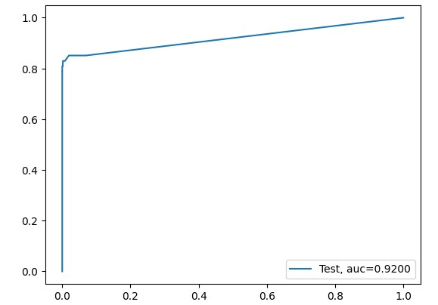
OverSampling with ADASYN Oversampling:
Results for ADASYN Oversampling with StratifiedKFold:
Looking at Accuracy and ROC value we have XGBoost which has provided best results for ADASYN Oversampling with the StratifiedKFOld technique.
Overall conclusion after running the models on Oversampled data:
Looking at above results it seems XGBOOST model with Random OverSampling with StratifiedKFold CV has provided the best results under category of all oversampling techniques. SO we will try to tune the hyperparameters of this model to get the best results.

Slide 19

Conclusion:
In the oversample cases, of all the models we build found that the XGBOOST model with Random OverSampling with StratifiedKFold CV gave us the best result accuracy and ROC on oversample data.
Post that we performed hyperparameter tuning and got the below metrics:
XGboost roc_value:0.9284470930852287
XGboost threshold:0.29035017
However, of all models we created we found Logistic Regression with L2 Regularisation for StratifiedKFold cross-validation (without Oversampling or under sampling ) gave us the best result.

Slide 20
Future scope
Explore the application of more advanced machine learning algorithms such as deep learning models like Convolutional Neural Networks (CNNs) or recurrent neural networks (RNNs) to improve fraud detection accuracy.
Investigate ensemble learning techniques to combine the strengths of multiple models, potentially enhancing the overall performance of the fraud detection system.
Incorporate more sophisticated feature engineering techniques to extract meaningful information from the available dataset, potentially uncovering hidden patterns indicative of fraudulent behavior.
Explore the use of anomaly detection algorithms, such as Isolation Forests or Autoencoders, to complement traditional classification approaches and identify novel forms of fraudulent activity.
Implement real-time fraud detection capabilities to enable immediate action upon detection of suspicious transactions, reducing the potential impact of fraud on financial institutions and cardholders.
Investigate the integration of additional data sources, such as user behavior analytics or contextual information, to further enhance the fraud detection system's accuracy and reliability.
Explore the use of explainable AI techniques to provide insights into the model's decision-making process, increasing transparency and trust in the fraud detection system.

Slide 21
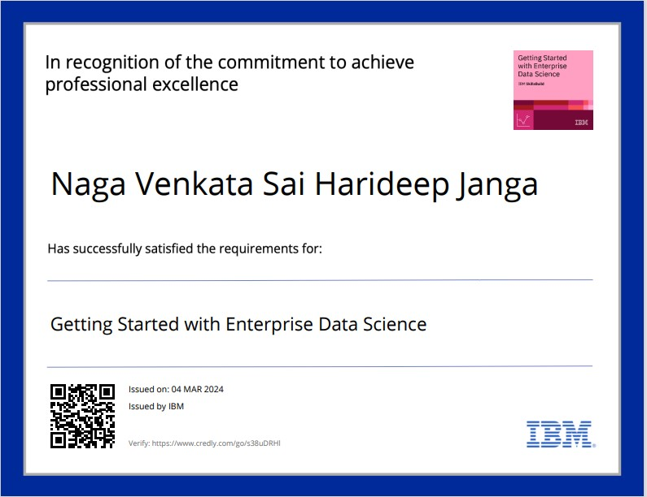
course certificate 1
Getting Started with Enterprise Data Science - Credly

Slide 22

course certificate 2
Journey to Cloud: Envisioning Your Solution - Credly

Slide 23
THANK YOU
STU626bd64950ee31651234377
Janga Naga Venkata Sai Harideep.
NOTE: Additionally I’m adding the project drive for your reference:
https://colab.research.google.com/drive/1thhk_FfKaeqkv353HRObv76HN9698yjX?usp=drive_link

